Slide 1
PEER HUB ImageNet Challenge 2018
Detection Task
Sai Prathap – 21ce01039

Slide 2
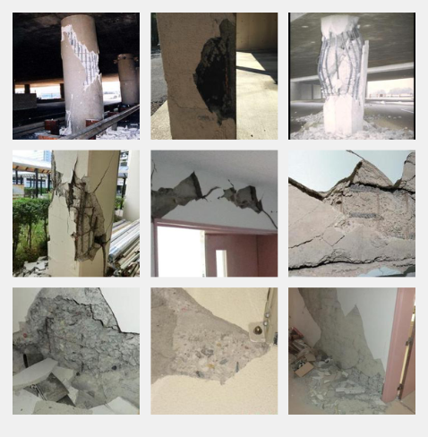
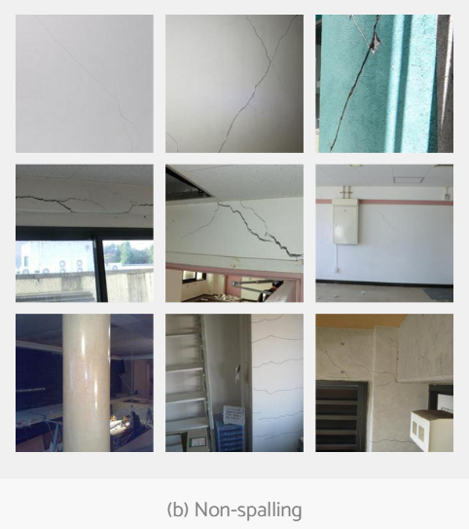
TASK 1
SPALLING CONDITION
BRIEF PROBLEM STATEMENT :
Spalling: Flakes of material break off from the surface
Structures Affected: Concrete, Masonry
Consequences: Chemical expansion, Mechanical forces(eg.,earthquakes)
Φ- Net Dataset: Images mainly from post-earthquake assessments
Task: Binary classification: SP/NSP
Spalling
Non spalling

Slide 3
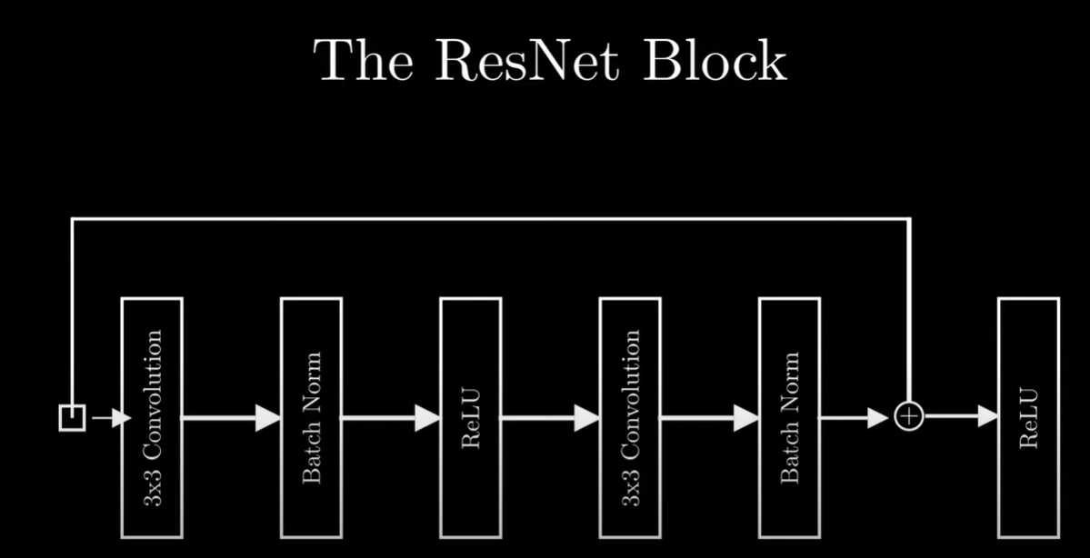
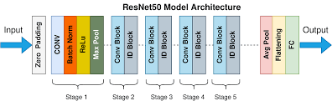
RESNET 50 MODEL
Core Structure:50 Layers: Composed of convolutional layers with batch normalization and ReLU activations.
Residual Blocks:Identity Block: No change in input/output dimensions.
Convolutional Block: Changes dimensions with strides >1.
Skip Connections: Links input of a block directly to its output to "skip" layers
.Final Layers: Global Average Pooling → Fully connected layer with softmax for classification.

Slide 4
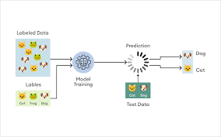
RESNET 50 MODEL
Purpose: Deep neural network for high-accuracy image recognition.
Key Component: Residual Learning,Uses skip connections (shortcut connections) to prevent vanishing gradient issues.
Reduces computation and model size, maintaining accuracy.
Uses:
Image Classification: High accuracy (e.g., ImageNet).
Object Detection: Backbone for detection models.
Image Segmentation: Detailed boundary detection.
Medical Imaging: Precise disease detection.

Slide 5
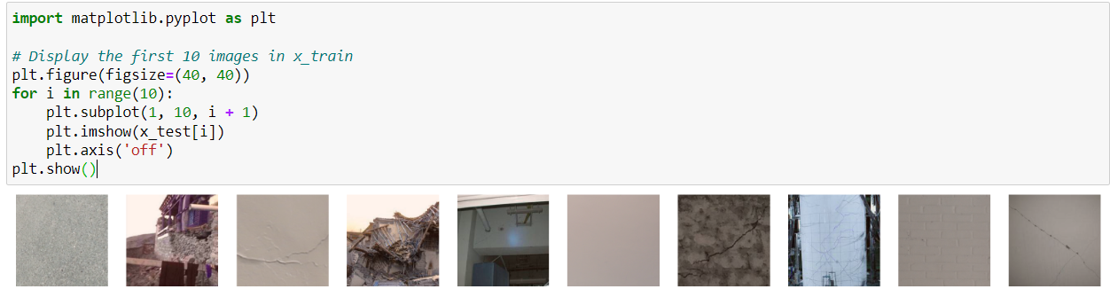
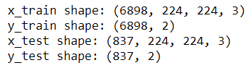
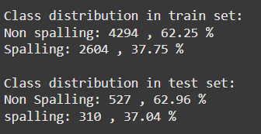
TASK 1
SPALLING CONDITION

Slide 6
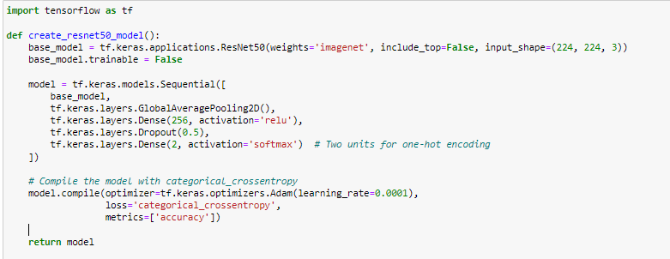
TASK 1
SPALLING CONDITION

Slide 7
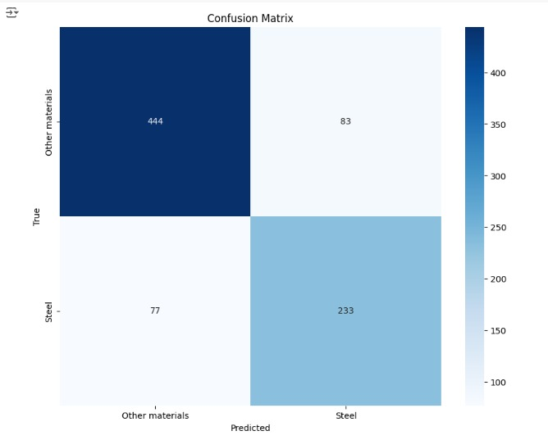
TASK 1 Results
Transfer Learning Model (ResNet50)
 | Precision | Recall | F1-score
Spalling | 0.74 | 0.75 | 0.74

Slide 8
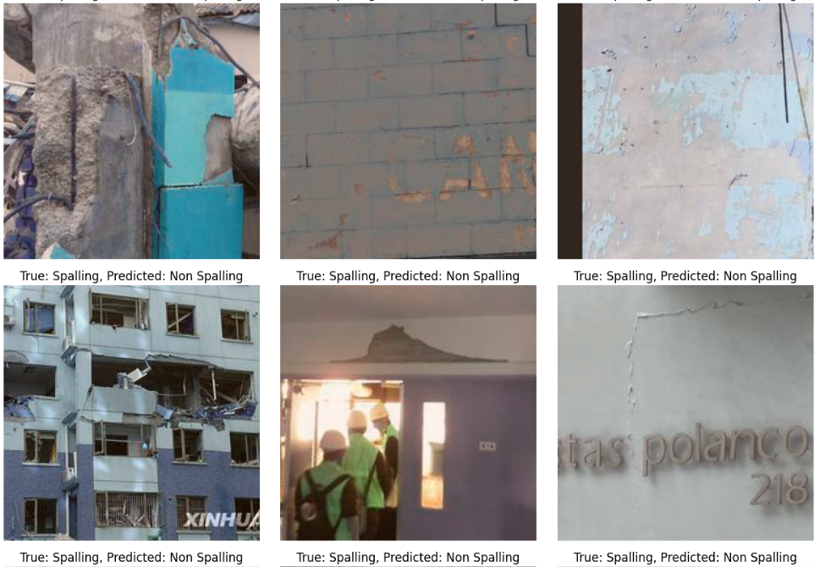

Slide 9
THANK
YOU!!!!!

